Slide 1

Insights from New York’s Airbnb analysis
For Data Analysis Managers and Lead Data Analyst
by PARITOSH AND BHAVENDRA SAHU

Slide 2
AGENDA
Objective
Background
Key findings
Recommendations
Appendix
Data sources
Data methodology

Slide 3
OBJECTIVES
Increase
Increase the market revenue of Airbnb, NYC after the impact of Covid-19 on economic conditions.
Improve
Improve our overall understanding of customer experiences and market conditions.
Provide
Provide important details and interesting insights to our Data Analysis Managers and Lead Data Analyst

Slide 4
BACKGROUND
For the past few months, Airbnb has seen a major decline in revenue due to the COVID-19 pandemic.
Now the travel restrictions have started lifting and people have started to travel more, Airbnb wants to make sure that it is fully prepared for this change.

Slide 5
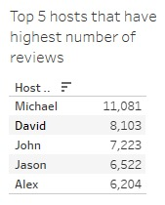
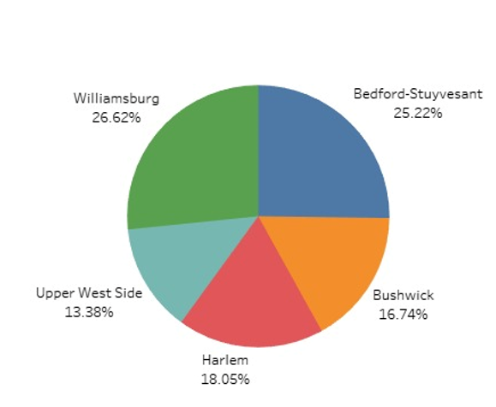
KEY FINDINGS
The top 5 hosts that have highest number of reviews are :- Michael, David, John, Jason and Alex.
The top 5 neighbourhoods that have large listings :- Williamsburg, Bedford-Stuyvesant, Harlem, Bushwick, Upper West Side.

Slide 6
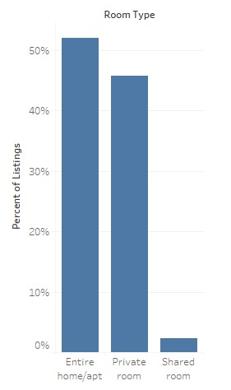
PREFERENCES OF CUSTOMERS TOWARDS PROPERTY TYPES
Most people are preferring to stay in Entire home/apt or private rooms in NYC.
Entire home/apt and private rooms are 97.6% of the total listed properties in NYC.
Shared rooms are only 2.37% of the total listed properties in NYC

Slide 7
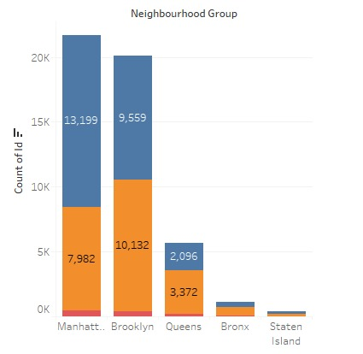

DENSITY OF LISTINGS WITH RESPECT TO NEIGHBOURHOOD GROUP AND ROOM TYPE
Most of the entire home/apt listings are in Manhattan as compared to the other neighbourhood groups.
Most of the private rooms listings are in Brooklyn as compared to the other neighbourhood groups.

Slide 8
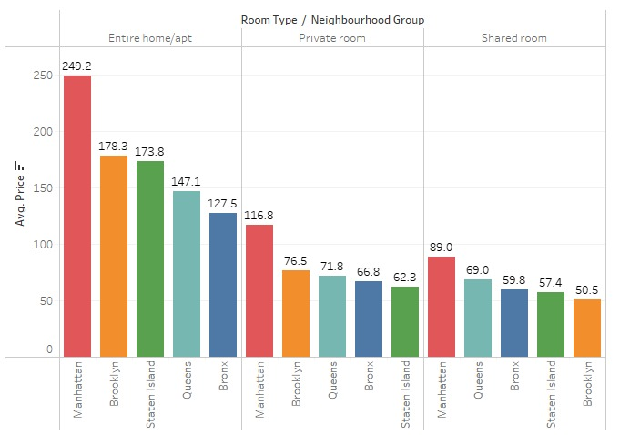
AVG. PRICE WITH RESPECT TO ROOM TYPE IN DIFFERENT NEIGHBOURHOOD
Avg. price of entire home/apt. is highest in Manhattan and lowest in Bronx.
Avg. price of private room is highest in Manhattan and lowest in Staten Island.
Avg. price of Shared room is highest in Manhattan and lowest in Brooklyn.

Slide 9
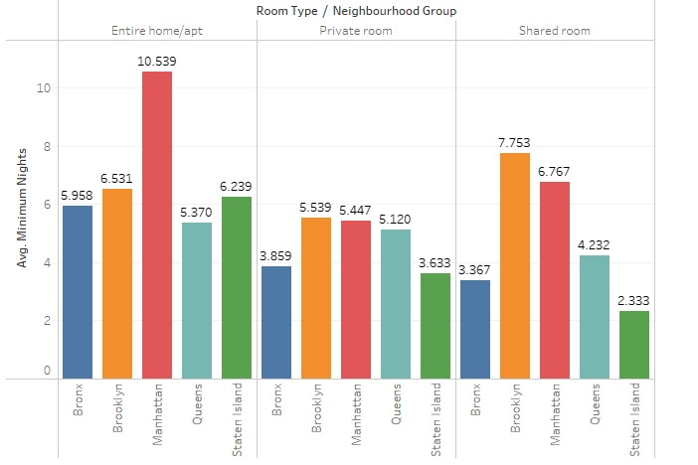
AVERAGE MINIMUM NIGHTS STAYED FOR EACH NEIGHBOURHOOD GROUPS AND ROOM TYPES
The highest avg. minimum nights stayed in entire home/apt is in Manhattan i.e. around 10 nights.
The lowest avg. minimum nights stayed in shared room is in Staten Island i.e. around 2 nights.
Customers prefer shared rooms of Brooklyn to stay in for longer periods around 7 nights.

Slide 10
RECOMMENDATIONS
Provide attractive offers for 10 and more days of minimum night stays. This will increase the revenue of AIRBNB.
Target the hosts having few properties and encourage them to list more properties. This will increase the listings on AIRBNB and help increase its revenue.
Encourage customers to provide feedback which will help understand the shortcomings and improve the services.

Slide 11
APPENDIX – DATA SOURCES
The team used the New York Airbnb data sources of year 2019.
The dataset contains information about different Airbnb listings along with their hosts, locations, prices and other attributes.

Slide 12
APPENDIX – DATA METHODOLOGY
We conducted a thorough analysis of the New York Airbnb dataset of 2019.
Complete Data understanding using Tableau and excel.
Findings and insights using bar graphs and other visual graphs.

